Slide 1

Generative Adversarial Network(GAN)
Presented By
Afia Anjum Id- 2014751124
Zinia Binte Jamal Id-2014751131
Farjana Sultana Rafi Id-2014751143
Sanzida Akter Chadne Id-2014751147
Guided By
Mrinmoy Biswas Akash
Lecturer of CSE department
Nourin Jahan Misho
Lecturer of CSE department

Slide 2
Outline
Introduction
Basic GAN architecture
Process and Method
Real World Example
Advantages
Disadvantages
Future Trends
Conclusion

Slide 3
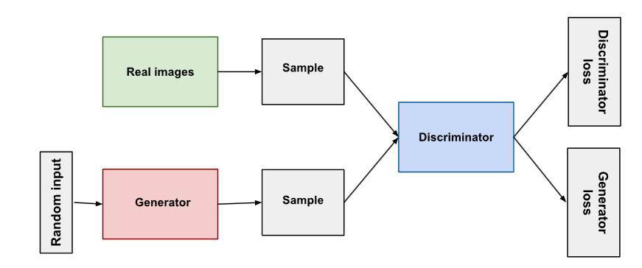
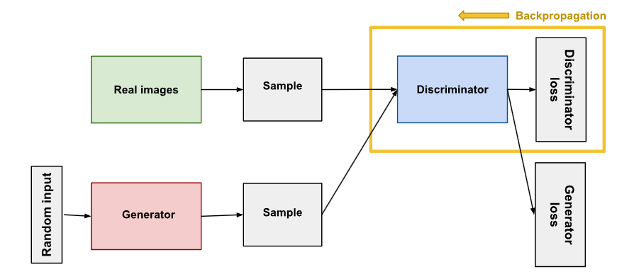
Introduction
1. A deep learning architecture deep learning architecture.
2. Consists of two neural networks.
3. GANs are designed to produce new, synthetic data with the aim of imitating a known data distribution.
.
Fig 1 : Putting data for GAN system

Slide 4
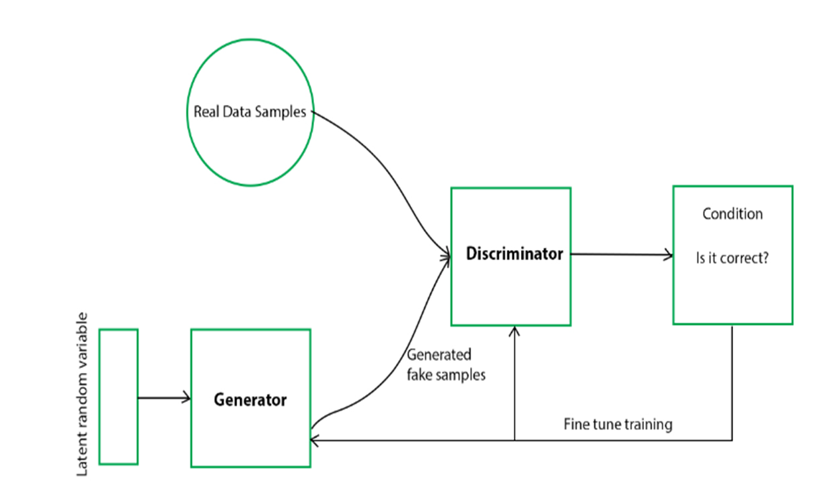
Basic GAN architecture
Generative adversarial networks (GANs) consist of two components:
1. The generator gains proficiency in producing credible data. The produced instances serve as the discriminator's negative training examples.
2. The generator's bogus data is distinguished from actual data via the discriminator. When the generator generates outcomes that are not credible, the discriminator penalizes it.
Fig 2:Basic GAN architecture

Slide 5
Process and Method
Gather the relevant dataset (Real Data for training).
Preprocess the data.
Choose an appropriate GAN architecture.
Train the GAN's generator.
The generator attempts to generate data that fools the discriminator.
The discriminator tries to correctly identify real from fake data.

Slide 6
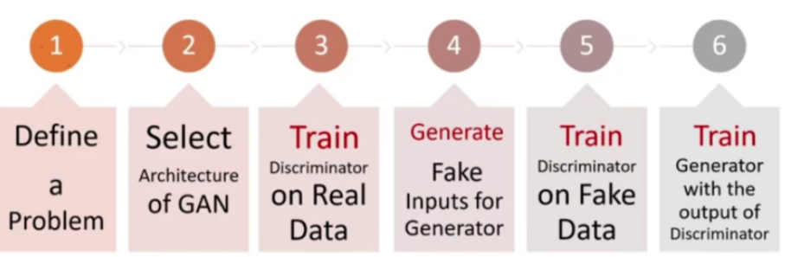
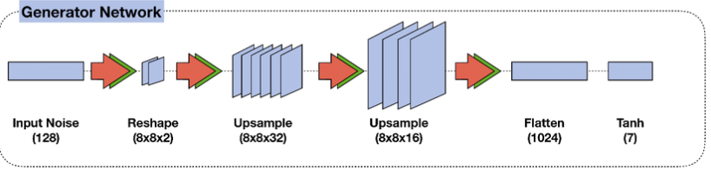
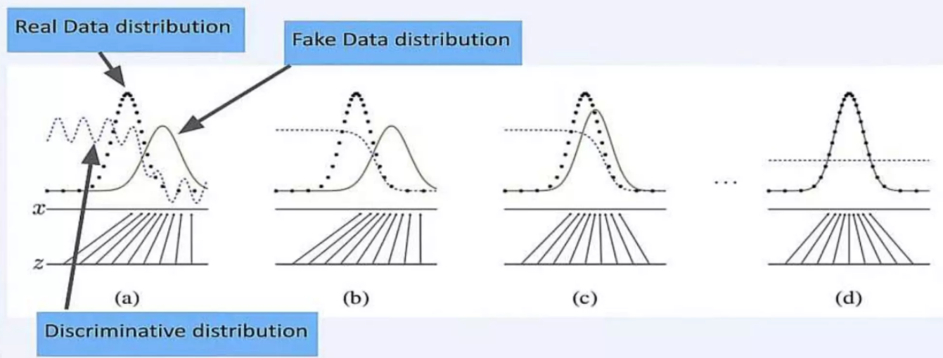
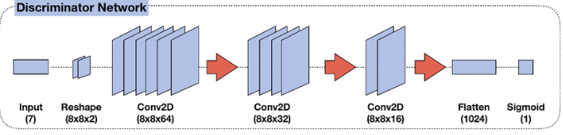
Process and Method
Fig 3:Process of GAN

Slide 7
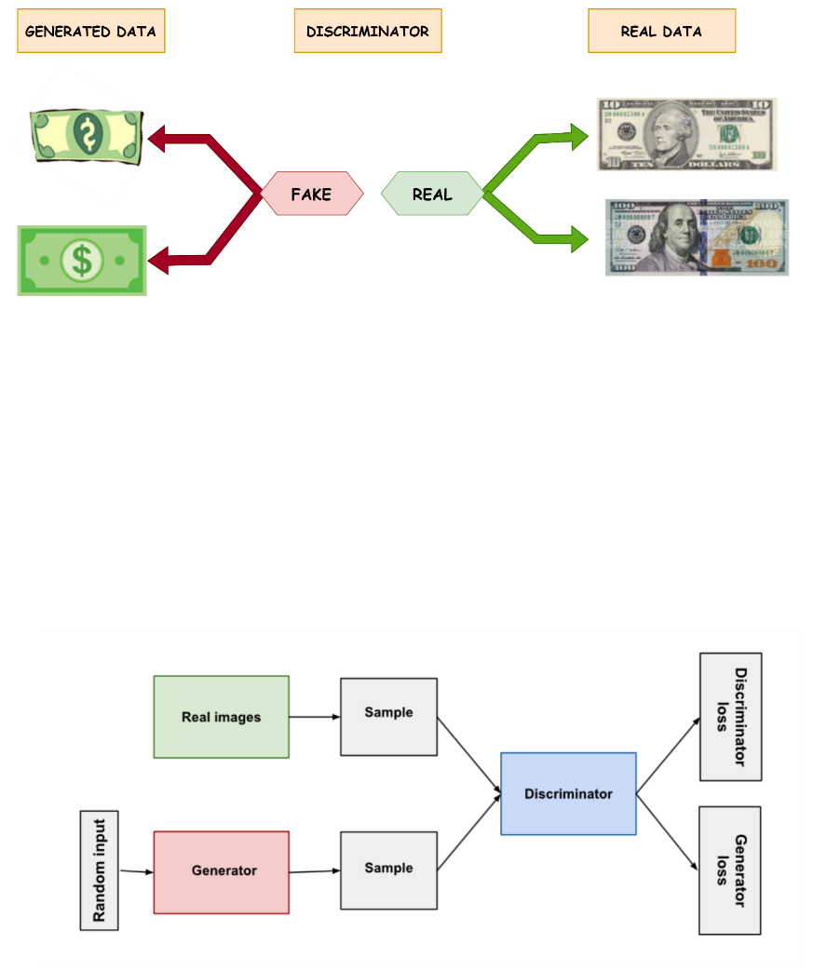
Process and Method
After all the processes GAN determines real data and fake data.
Fig 4:Determinig real and fake data using GAN

Slide 8
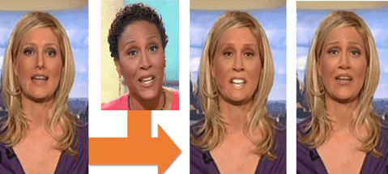
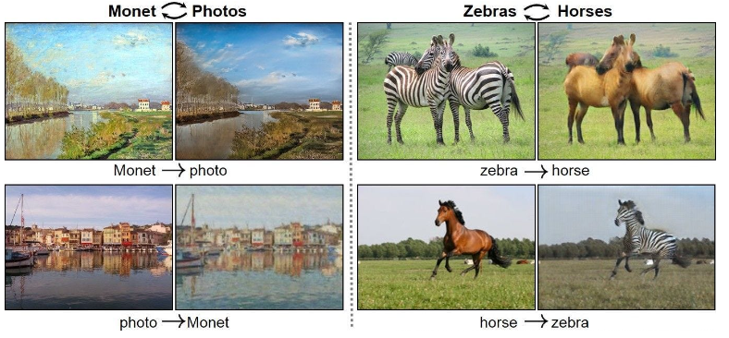
Real World Example
Entertainment Industry: GANs enhance special effects in movies and TV, creating the illusion of actors performing daring stunts.
Top of Form Face Swap Apps: Many apps and software use GANs to replace faces in photos and videos for entertainment and social media sharing.
Educational and Training Content: GANs create realistic training simulations for fields like medicine and virtual education.
Forensics and Research: GANs are used in digital forensics to detect and counter deep fake content.
Fig 5 : Face Swap Apps
Fig 6 : Entertainment Industry

Slide 9
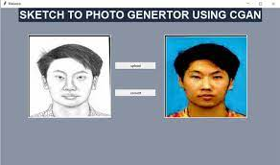
Advantage
Advantages of Generative Adversarial Networks (GANs):
1. High-Quality Data Generation: GANs create realistic data.
2. Unsupervised Learning: GANs learn from unlabelled data.
3. Variety and Creativity: GANs offer diverse content generation.
4. Data Augmentation: GANs enhance datasets for better model training.
5. Privacy-Preserving Data: GANs generate synthetic data while protecting privacy.
6. Image Editing: GANs help fill in missing image parts and improve photos.
Fig 7:Sketch to photo generator using CGAN

Slide 10
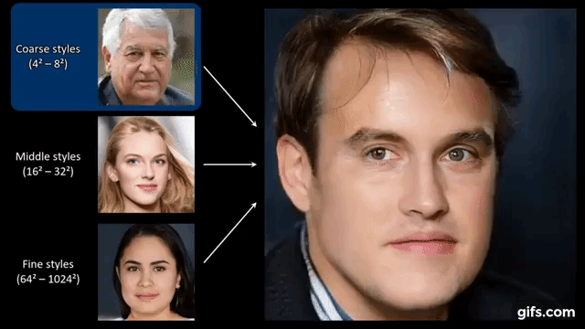
Disadvantages
Disadvantages of Generative Adversarial Networks (GANs):
Mode Collapse: GANs can generate repetitive output.
Training Instability: Finding the right balance in training can be challenging.
Data Quality Dependency: GANs require high-quality training data.
Hyperparameter Tuning: Setting parameters can be tricky.
Fig 8:Making Fake Image

Slide 11
Future Trends
Future Trends Data Augmentation: GANs can enhance datasets for better data mining results.
Anomaly Detection: GANs help identify outliers in data, valuable for fraud detection.
Imbalanced Data Handling: GANs address class imbalance issues in data mining.

Slide 12
Conclusion
GANs are a potent machine-learning technique.
They enable the creation of realistic data.
Applications include image generation, style transfer, data augmentation, and deep fake detection.
Challenges like mode collapse prompt ongoing research and development.
Researchers continuously work on new GAN variants and techniques to overcome these challenges.

Slide 13


